Slide 1
Side-channel Attack on 3D Printers
Yihan Ping, Shuheng Liao, Sangram Rout, Ziyao Jiang

Slide 2
Why we need to protect intellectual property
intellectual property = IP
Notes:
The purpose of our project is to protect the IP in additive manufacturing, especially in 3D printing.
Before people know the way of protection, they need to know the way of attack.
We will try to act as attackers and try to obtain the 3D modelling information with side-channel method.
For now, the world’s economy depends heavily on IP (intellectual property)
In the US alone, the IP-intensive industries have been known to account for 34.8% of the U.S. GDP.
The fighting on protecting the IP has lasted for generations.
REDUCE

Slide 3
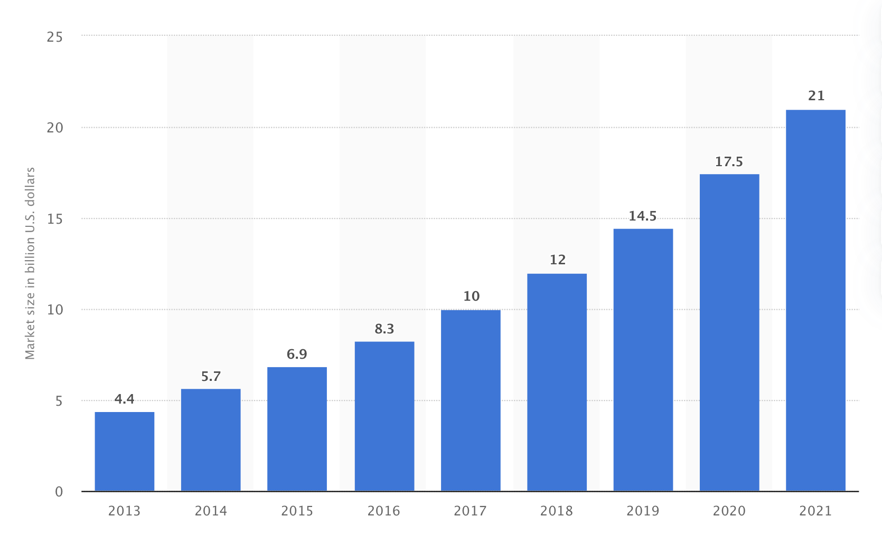
Market size of 3D printing worldwide
Data source: statista.com
Notes:
There is also a huge market of additive manufacturing
Huge market in 3D printing
Only in 3D printing, estimated, the market size 21 Bl dollar by 2021
IP in additive manufacturing consists of the internal and external structure of the object, the process parameters, and the machine specific tuning parameters [11].

Slide 4
Notes:
To produce a 3D object, design information (which contains IP) is supplied to the manufacturing system in the form of G-code.
G-code is a language in which people tell computerized machine tools how to make something. It primarily used to control the system components and parameters such as speed, temperature, and extrusion amount.
With G-code, the trajectory of the additive manufacturing nozzle could be known. Theoretically, we also could know the 3D model information with G-code if we do the reverse engineering project.
So, G-code is crucial in additive manufacturing process.
In our project, we will try to get the G-code use unusual method.
Currently: IP leak is mainly through cyber domain (operation aurora, GhostNet) , it could also leak through physical AKA side-channel, domain.
The cyber attack has already been studied by a lot of researchers. However, the side-channel method has rarely been focused.
Side-channel attack is described as any attack based on information gained from the implementation of a computer system, rather than weaknesses in the implemented algorithm itself (e.g. cryptanalysis and software bugs).
Many physical information, like acoustic emissions, timing information, light emission, and power consumption could be used in side-channel attack.
EXAMPLE: In our project, we try to use a phone to record the acoustic information and use it for cyber attack.

Slide 5
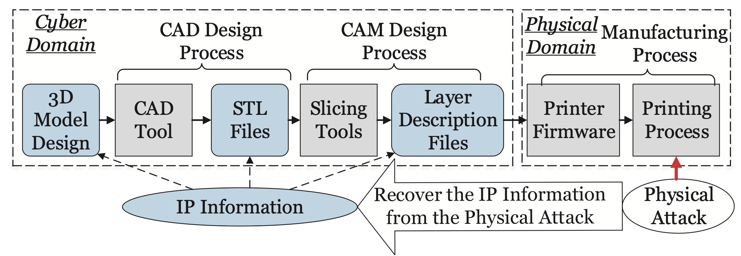
Physical Information
IP information
Reverse engineering
Source: Al Faruque, M., Chhetri, Canedo, and Jiang Wan. "Acoustic Side-Channel Attacks on Additive Manufacturing Systems." 2016 ACM/IEEE 7th International Conference on Cyber-Physical Systems (ICCPS) (2016): 1-10. Web.
Notes:
In a typical additive printing process,
Designers can start their design of 3D objects by modeling tools such as Sketchup. Next, a Computer-Aided Design (CAD) tool generates a standard StereoLithography, AKA STL, for the manufacturing purpose. Computer Aided Manufacturing (CAM) process is then required to slice the STL file into layer-by-layer description file (e.g. G-code, cube, etc.). Then, the layer description file will be sent to the manufacturing system (e.g. 3D printer) for production.
In the physical domain of the additive manufacturing, components such as stepper motor, fan, extruder, base plate etc, carry out operations on the basis of information provided by the cyber domain (G-code). In carrying out the operation, these physical components leak cyber domain information (G-code) from the side-channels, such as acoustic and power, which can be used to steal IP by performing physical-to-cyber domain attack.
Our side-channel attack mainly focus on the the acoustic domain, that is about using the sound information to recover the Layer Description files, then, the 3D model
Generally speaking, our work is a process of reverse engineering.

Slide 6
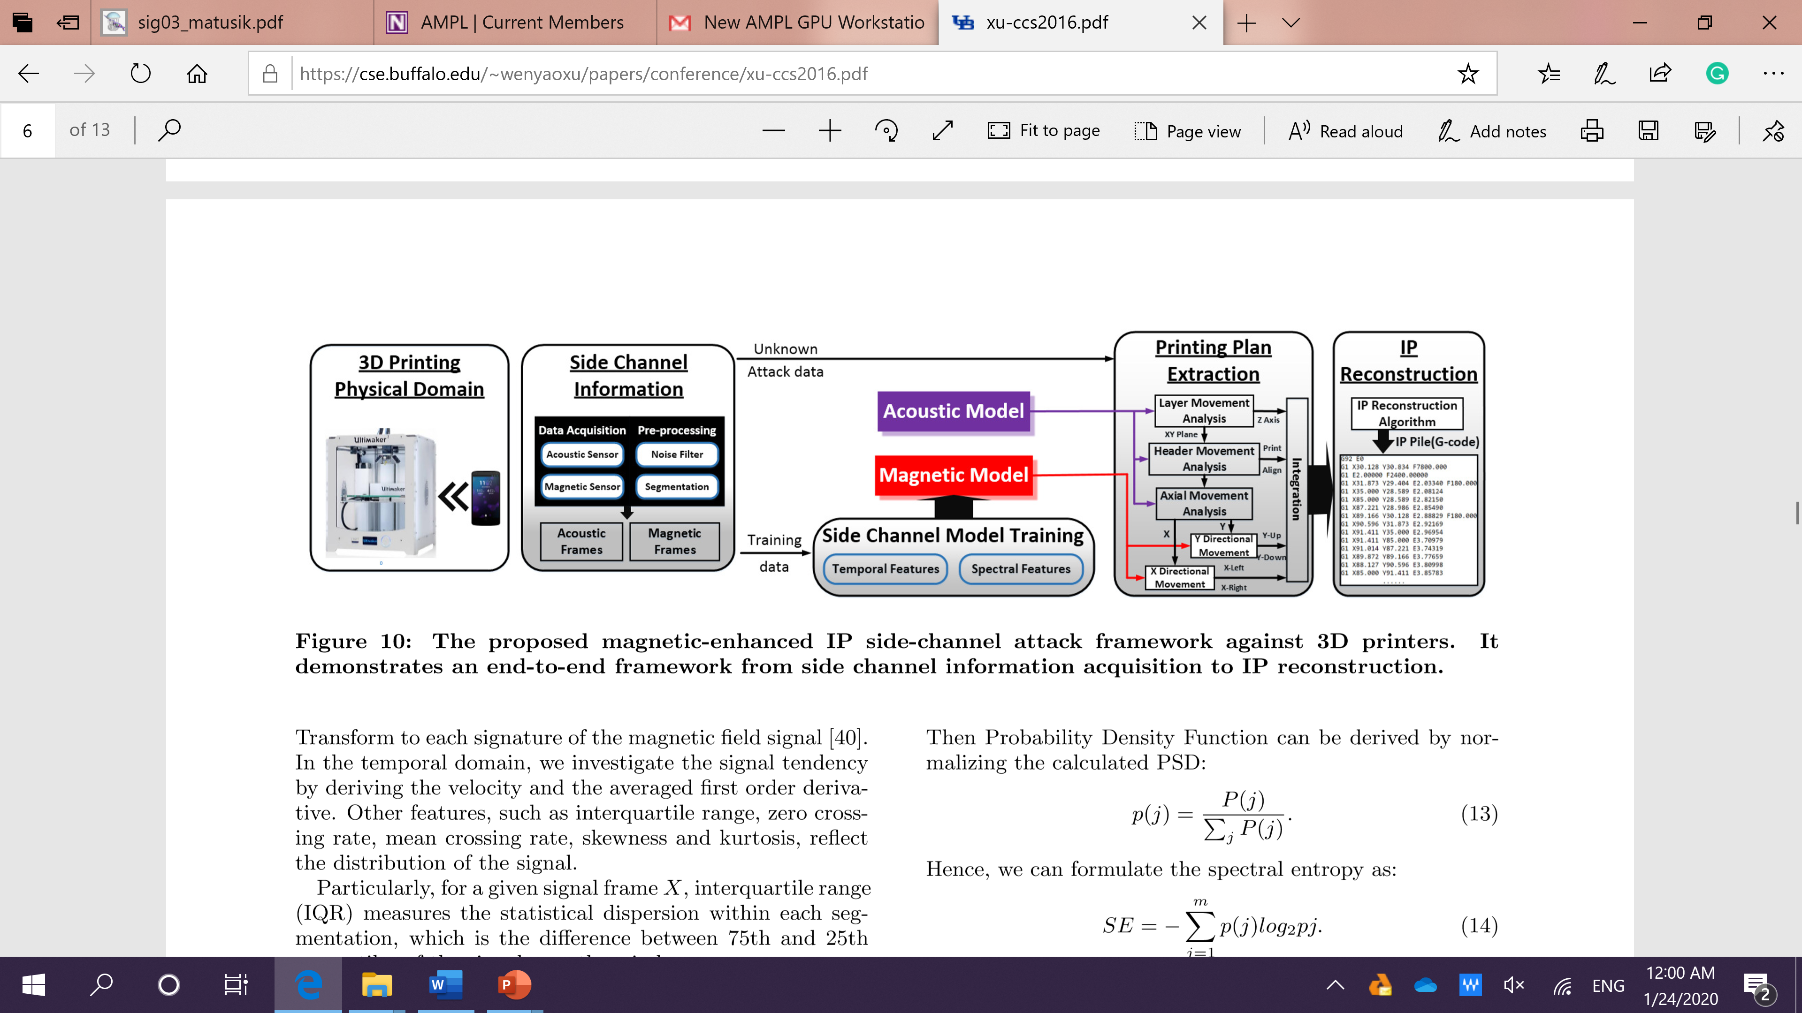
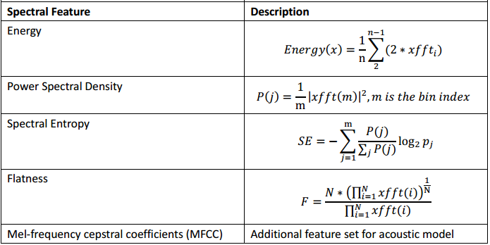
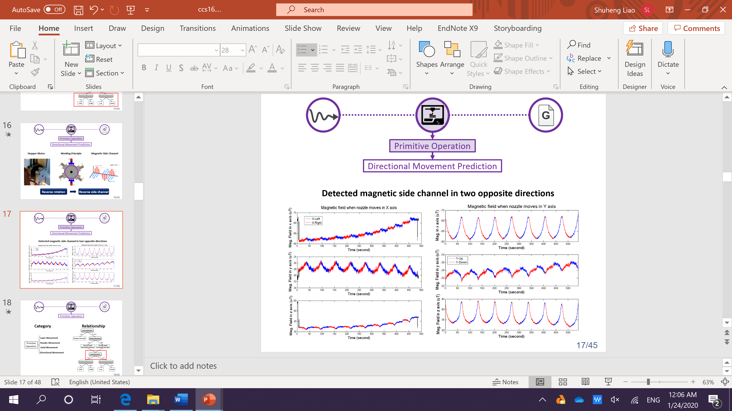
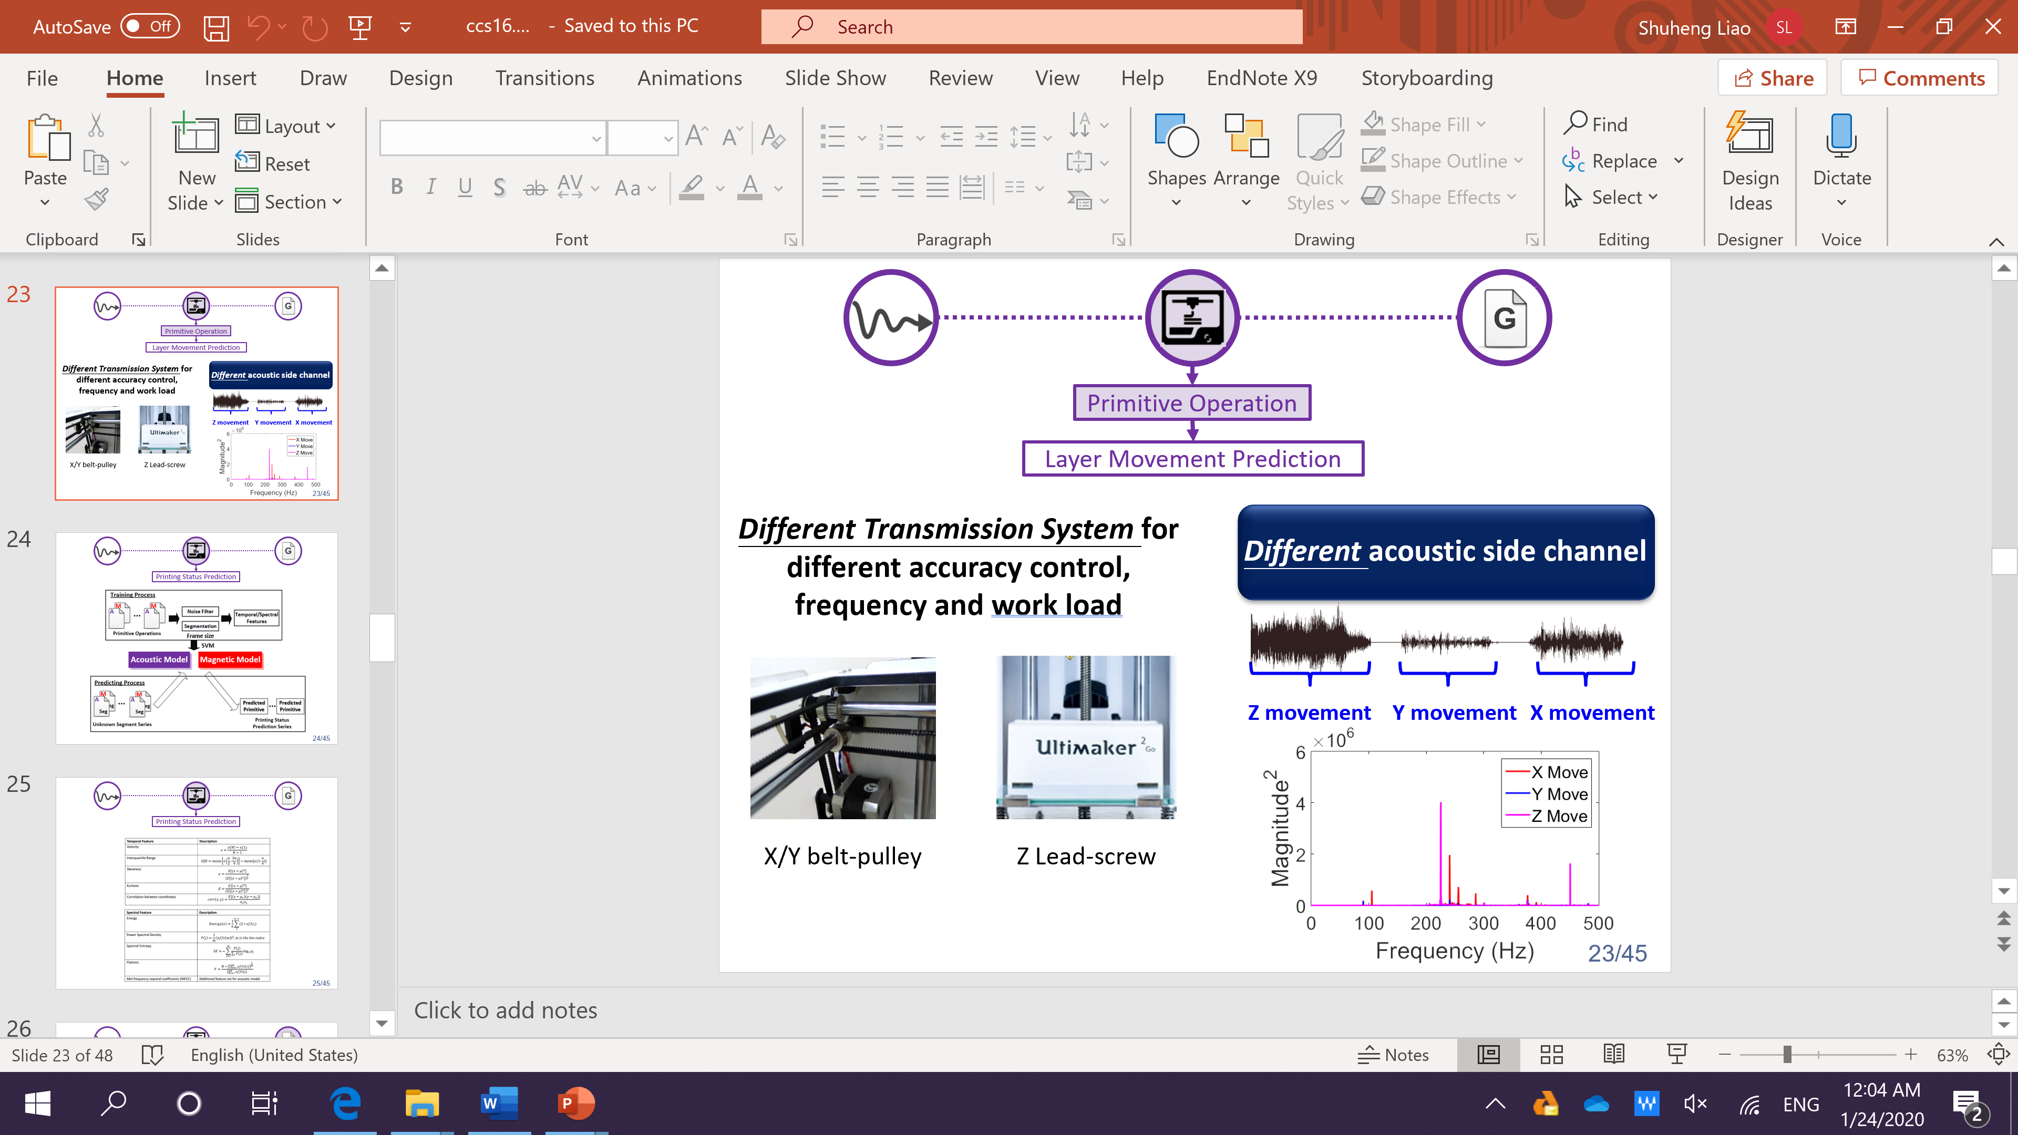
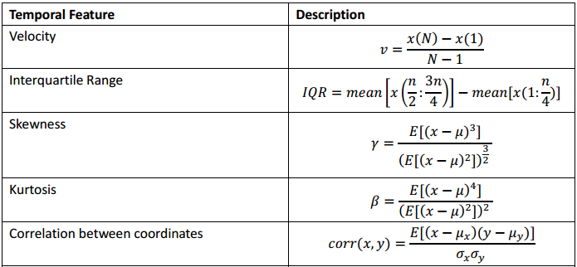
Potential Method
z
y
x
Song, Chen, et al. "My smartphone knows what you print: Exploring smartphone-based side-channel attacks against 3d printers." Proceedings of the 2016 ACM SIGSAC Conference on Computer and Communications Security. 2016.

Slide 7
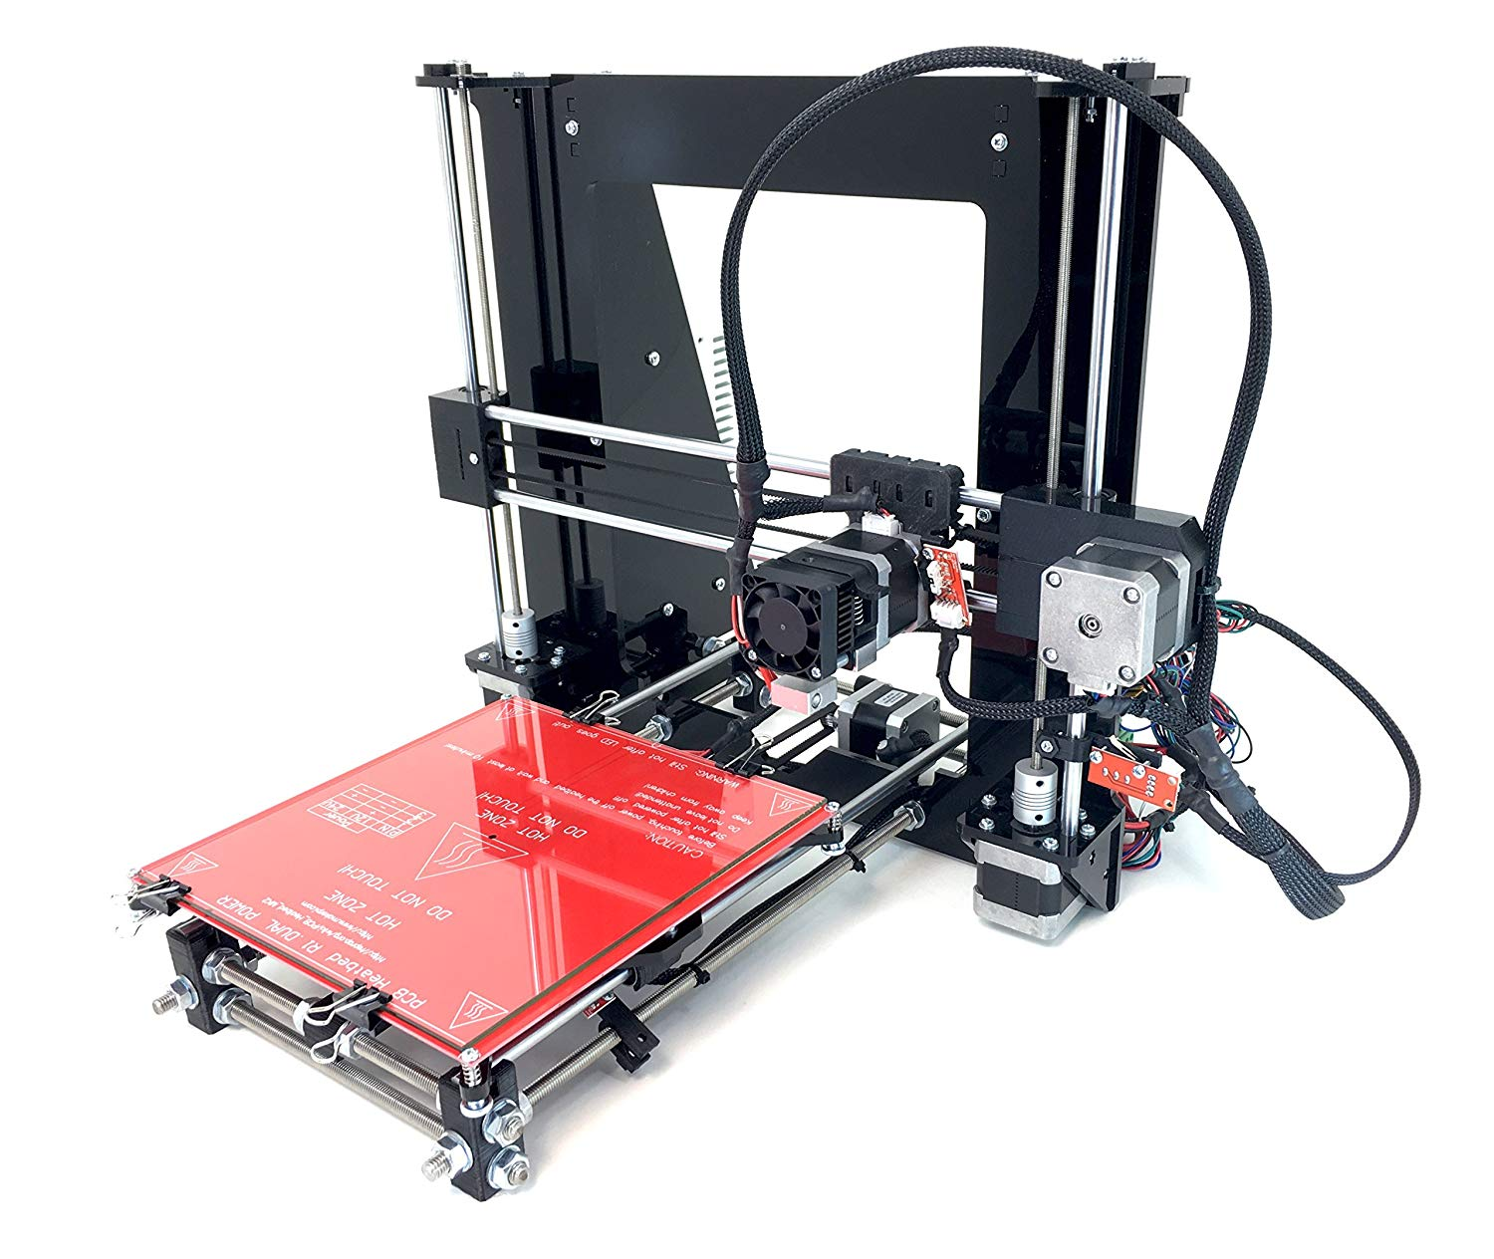
REPRAPGURU Prusa I3 3D Printer
Build volume: 25 x 21 x 21 cm | 9,84 x 8,3 x 8,3 in
Layer height: 0.05 – 0.35 mm
Pros
Heat Bed (ABS filament objects)-Fused Deposition Modeling
Lower Price
Stellar Support from the manufacturer
Nozzle different/motor same/Load different
PICTURE ASSEMBLY
Notes:
Data base model.
Made in resolution of 1 degrees

Slide 8

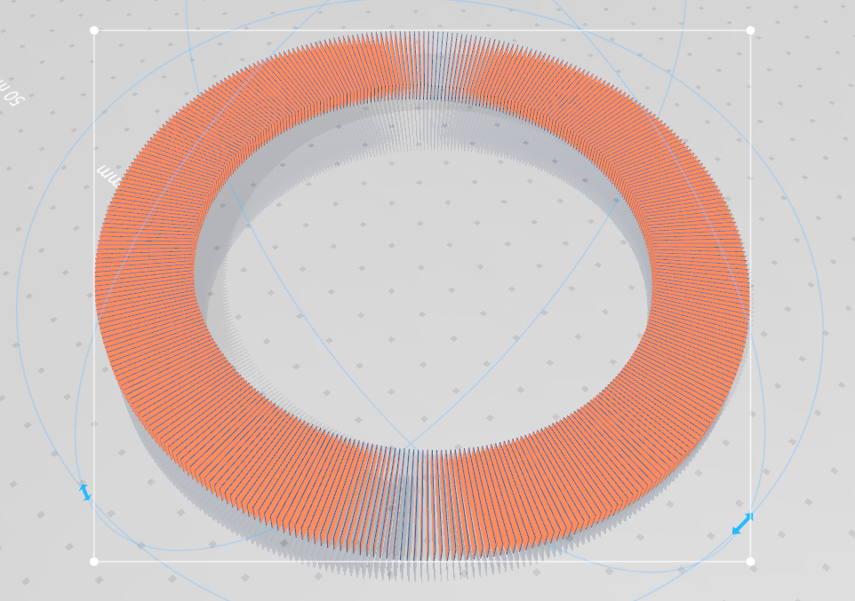
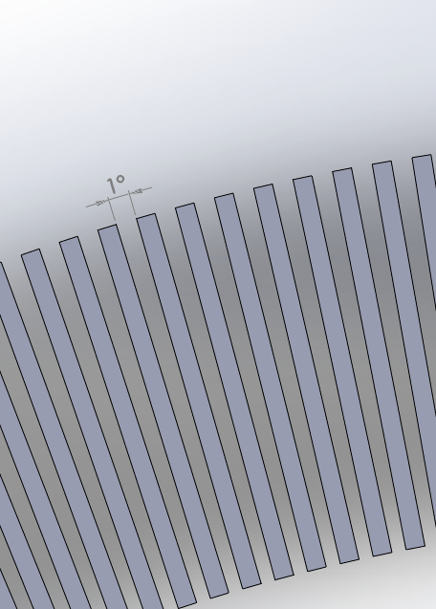
Experiment
Step 1. Formation of database/library
Pattern drawn with 1°
360 ° covered.
Notes:
Data base model.
Made in resolution of 1 degrees

Slide 9
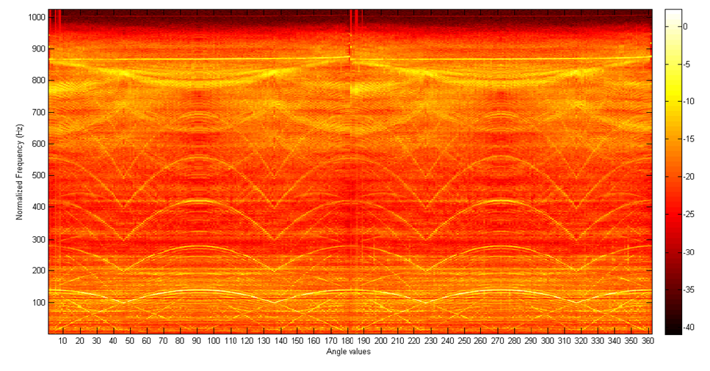
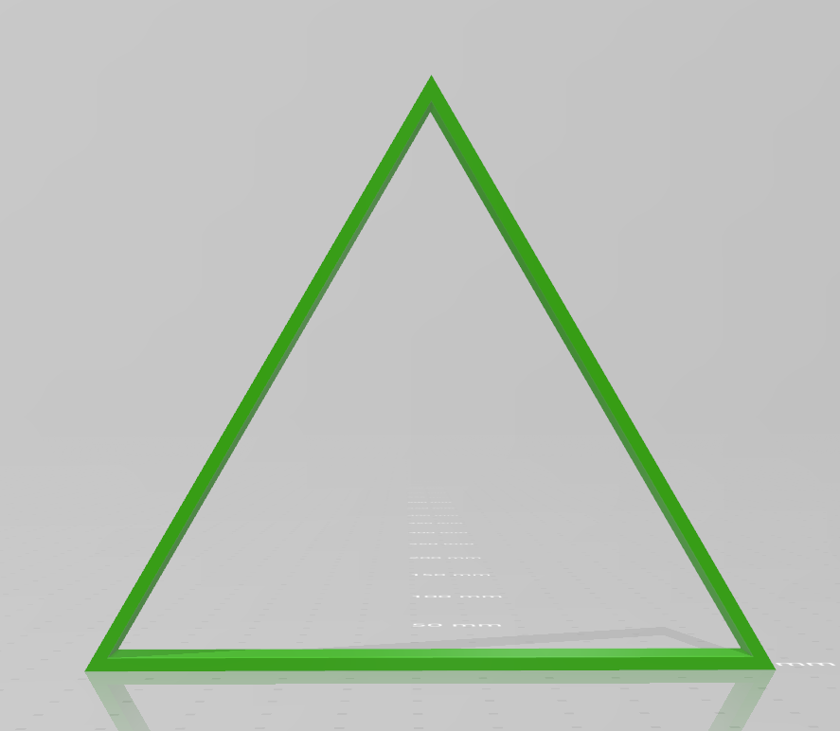
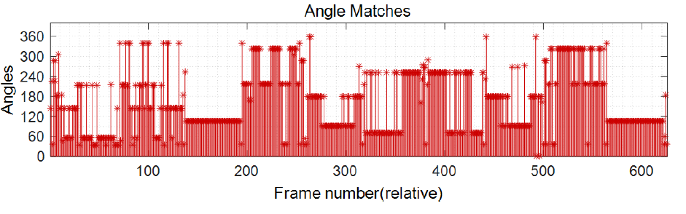
Experiment
Step 1. Form a database/library
Step 2. Pre-process the data
Step 3. Identify conditions indicators
Step 4. Train models
Step 5. Validate with experiment sample
Notes:
Data base in the form of a spectrogram.
Angles corresponding to each

Slide 10
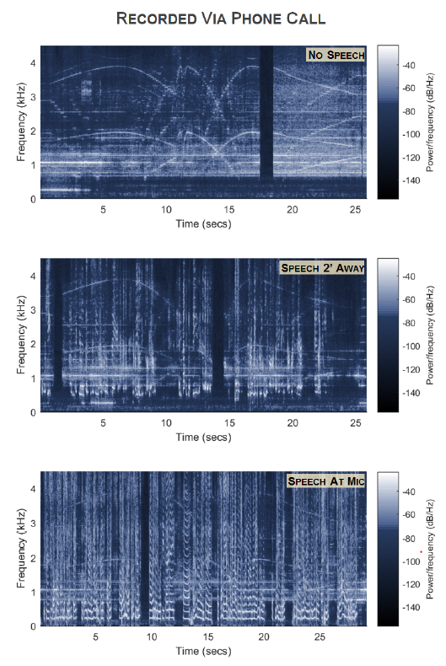
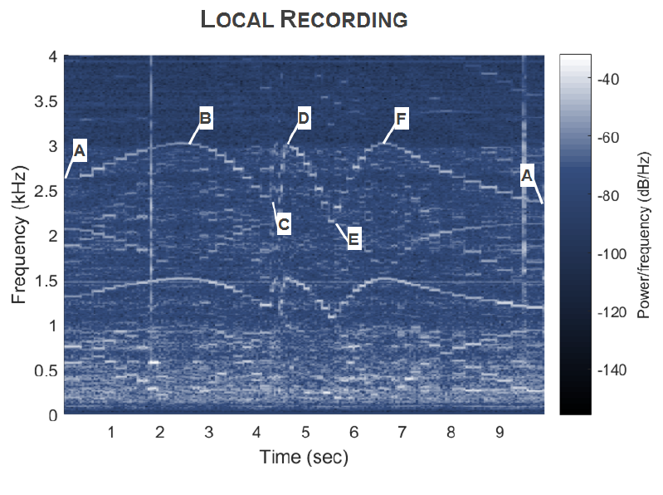
Experiment
Effect of speech
Leave Your Phone at the Door: Side Channels that Reveal Factory Floor Secrets Avesta Hojjati, Anku Adhikari, Katarina Struckmann, Edward J. Chou, Thi Ngoc Tho Nguyen, Kushagra Madan, Marianne S. Winslett, Carl A. Gunter, William P. King
Notes:
Effect of speech
The speech overlaps the information-rich regions of the spectrogram.
the audio signal will have been altered by the phone’s noise reduction but they are in the same frequencies in the human speech region.
Audio recorded with phone call consistent with audio recording.
With speech not completely obsured.

Slide 11


Additional Reference
Click Here
Click Here
Thank you
Questions?

